Slide 1
Evolution in Audio Deepfake Detection
Arth J. Shah
(202521004)
Course evaluation presentation of Advance Machine Learning (AML)
under Supervision of
- Prof. (Dr.) Rachit Chhaya
27th April, 2026

Slide 2
Presentation Overview
Introduction to Audio Deepfake Deepfake (ADD) and literature survey.
Introduction to RawNet2 -> AASIST -> AASIST3 -> Rawformer.
Experimental setup & Results.
Summary and conclusion.
Open research problems.

Slide 3
What is Deepfake?
Any AI generated content, produced via deep learning method can be called as deepfake.
Deepfakes are generally created to fool humans rather than spoofing systems.
Applications: - Social media platforms - Voice-controlled assistants - Biometric authentication systems

Slide 4
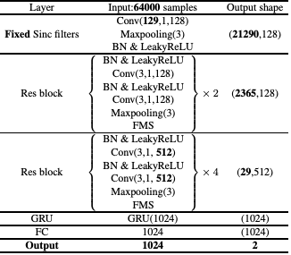
RawNet2
Source: Tak, H., Patino, J., Todisco, M., Nautsch, A., Evans, N., & Larcher, A. (2021, June). End-to-end anti-spoofing with rawnet2. In ICASSP 2021-2021 IEEE International Conference on Acoustics, Speech and Signal Processing (ICASSP) (pp. 6369-6373).

Slide 5
RawNet2 Sub-Modules Overview
SincConv Frontend → Raw waveform → learnable band-pass filters (mel-init)
Initial Processing → |x| + pooling + BN + SELU
Residual CNN Stack
Channel Attention & GRU layer
FC Head → Final classification

Slide 6
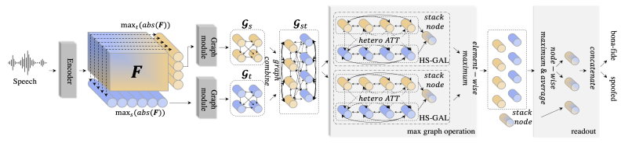
AASIST Overview
Source: Jung, Jee-weon, et al. "Aasist: Audio anti-spoofing using integrated spectro-temporal graph attention networks." ICASSP 2022-2022 IEEE international conference on acoustics, speech and signal processing (ICASSP), 2022.

Slide 7
AASIST Sub-Modules Overview
RawNet2 Encoder
Lower Feature Maps (LFM) & Higher Feature Maps (HFM).
Graph Modules & Graph Combine
Heterogeneous Attention & Stack node
Element wise Max/Min operator & Readout

Slide 8
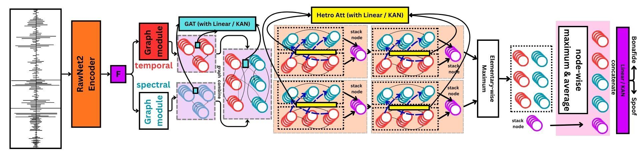
AASIST-3 Overview
Source: Borodin, Kirill, et al. "AASIST3: KAN-enhanced AASIST speech deepfake detection using SSL features and additional regularization for the ASVspoof 2024 Challenge." Proc. ASVspoof, INTERSPEECH, 2024.

Slide 9
AASIST3 Sub-Modules Overview
RawNet2 Encoder
Lower Feature Maps (LFM) & Higher Feature Maps (HFM).
Graph Modules (With KAN) & Graph Combine (With KAN)
Heterogeneous Attention & Stack node
Element wise Max/Min operator & Readout (Via KAN Linear layer)

Slide 10
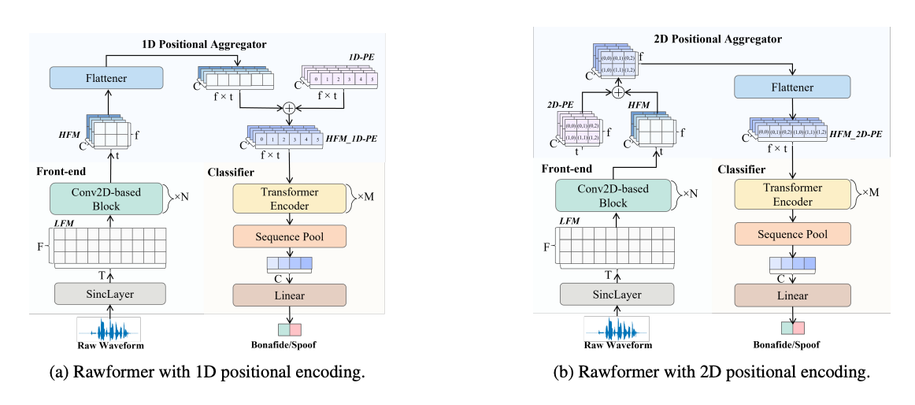
RawFormer Overview
Source: Liu, X., Liu, M., Wang, L., Lee, K. A., Zhang, H., & Dang, J. (2023, June). Leveraging positional-related local-global dependency for synthetic speech detection. In ICASSP 2023-2023 IEEE International Conference on Acoustics, Speech and Signal Processing (ICASSP) (pp. 1-5).

Slide 11
RawFormer Sub-Modules Overview
Pre-Emphasis + Sinc Frontend
2D CNN Feature Extractor (LFM → HFM)
Positional Encoding + Flattening
Transformer Encoder Stack (MHSA + FFN)
Sequence Pooling + Classification

Slide 12
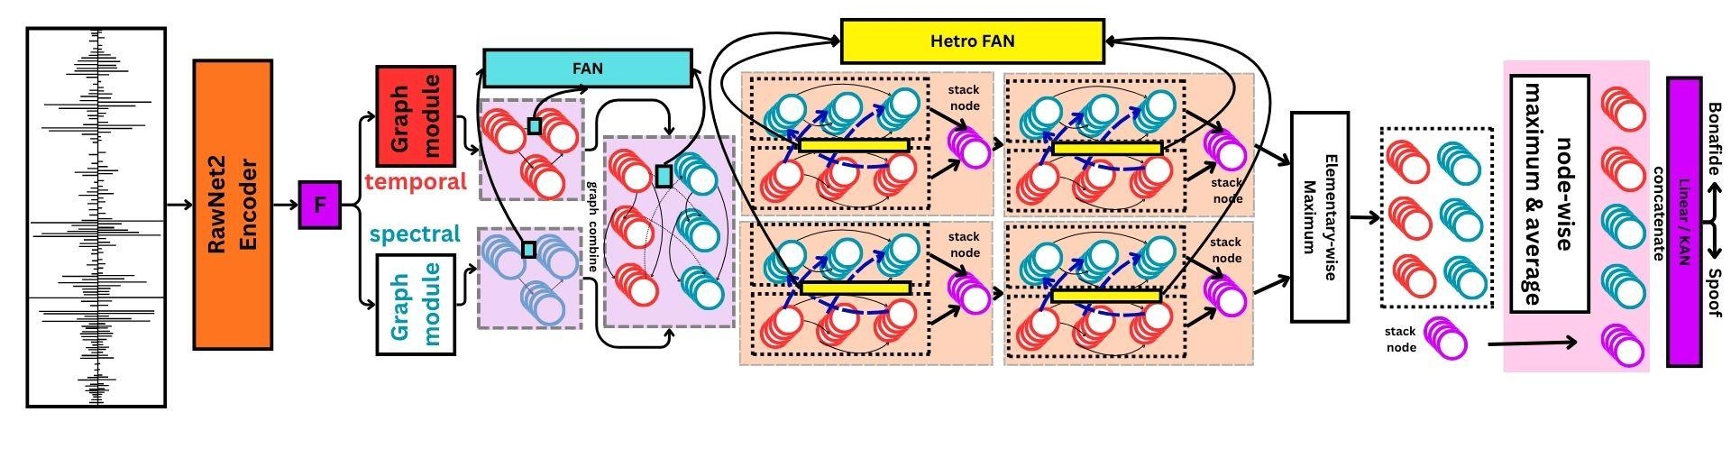
FAN-AASIST Overview
Source: Liu, X., Liu, M., Wang, L., Lee, K. A., Zhang, H., & Dang, J. (2023, June). Leveraging positional-related local-global dependency for synthetic speech detection. In ICASSP 2023-2023 IEEE International Conference on Acoustics, Speech and Signal Processing (ICASSP) (pp. 1-5).

Slide 13
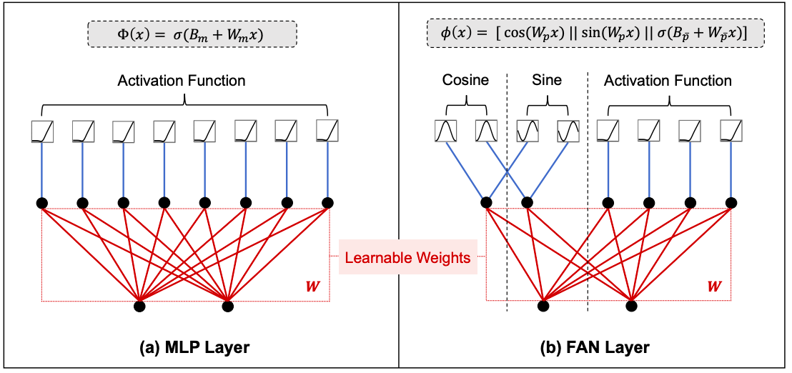
FAN-AASIST Overview
Source: Yihong Dong, Ge Li, Yongding Tao, Xue Jiang, Kechi Zhang, Jia Li, Jinliang Deng, Jing Su, Jun Zhang, and Jingjing Xu, “Fourier analysis network,” in NeurIPS, 2025, San Diego, CA.

Slide 14
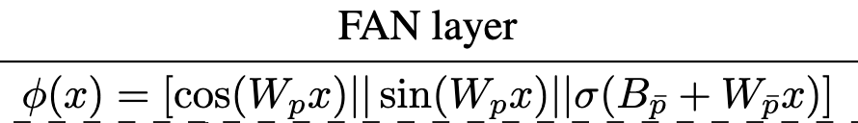
FAN-AASIST Sub-Modules Overview
All the submodules are same as AASIST, Just replaced attention with FAN to capture sequential characteristics.
Unlike self-attention, which computesdense pairwise interactions, FAN decomposes each input into periodic and non-periodic components.

Slide 15
Experimental Setup
Dataset: ASVSpoof 2019
Training duration of audios: 2 Seconds with 16k sampling rate
# of filters in Sinc-conv layer: 70
# of ResNet2 blocks in encoder: 06
Optimizer and Learning Rate: Adam, and 10^-4.
Epochs: 5
Performance Metrices: Variable

Slide 16
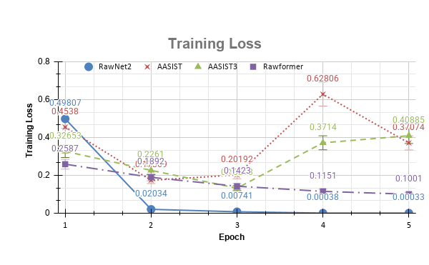
Experimental Results

Slide 17
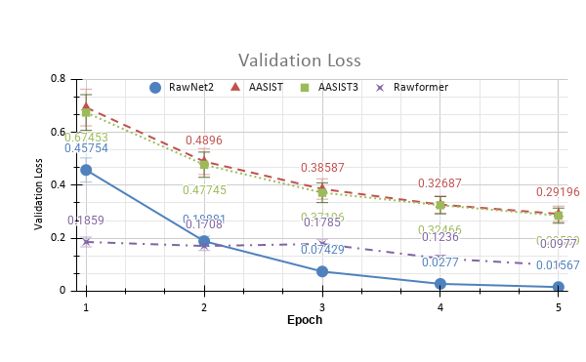
Experimental Results

Slide 18
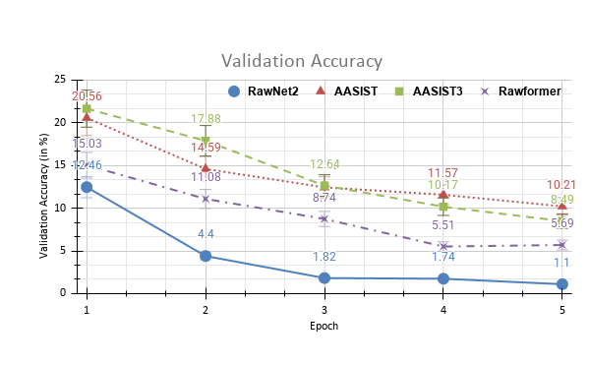
Experimental Results

Slide 19
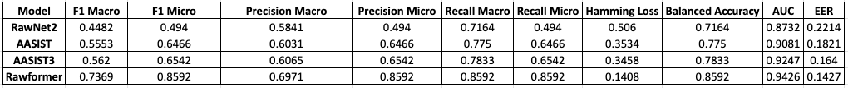
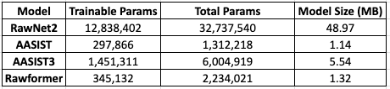
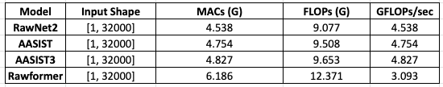
Experimental Results

Slide 20
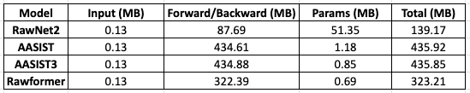
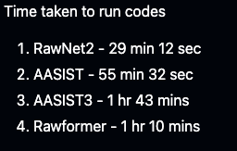
Experimental Results

Slide 21
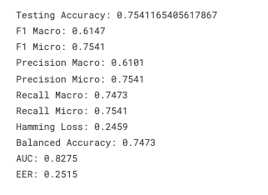
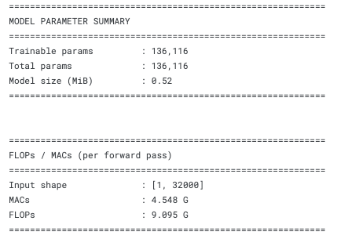
Experimental Results (FAN)
Observations: Not working good.

Slide 22
Summary & Conclusions
I explored 4 existing models, and tried evolving it in one another model.
I failed, but i learned
Models and data organization.
What is the key in evolution.
Why Graph attention.
Why sequential attention.
What Can be next ??
=> Nested Learning

Slide 23
Refrences
[1] ASV19 dataset => M. Todisco, X. Wang, V. Vestman et al., “Asvspoof 2019: Future horizons in spoofed and fake audio detection,” in Proc. INTERSPEECH, 2019.
[2] RawNet2 => H. Tak, J. Patino, M. Todisco et al., “End-to-end anti-spoofing with rawnet2,” in Proc. ICASSP, 2021.
[3] AASIST => Jung, Jee-weon, et al. "Aasist: Audio anti-spoofing using integrated spectro-temporal graph attention networks." ICASSP 2022-2022 IEEE international conference on acoustics, speech and signal processing (ICASSP), 2022.
[4] AASIST3 => Borodin, Kirill, et al. "AASIST3: KAN-enhanced AASIST speech deepfake detection using SSL features and additional regularization for the ASVspoof 2024 Challenge." Proc. ASVspoof, INTERSPEECH, 2024.
[5] Rawformer => Liu, X., Liu, M., Wang, L., Lee, K. A., Zhang, H., & Dang, J. (2023, June). Leveraging positional-related local-global dependency for synthetic speech detection. In ICASSP 2023-2023 IEEE International Conference on Acoustics, Speech and Signal Processing (ICASSP) (pp. 1-5).
[6] FAN => Yihong Dong, Ge Li, Yongding Tao, Xue Jiang, Kechi Zhang, Jia Li, Jinliang Deng, Jing Su, Jun Zhang, and Jingjing Xu, “Fourier analysis network,” in NeurIPS, 2025, San Diego, CA.

Slide 24
Thank You …

